Slide 1
HABs with Sentinel-2
Keenan Ganz

Slide 2
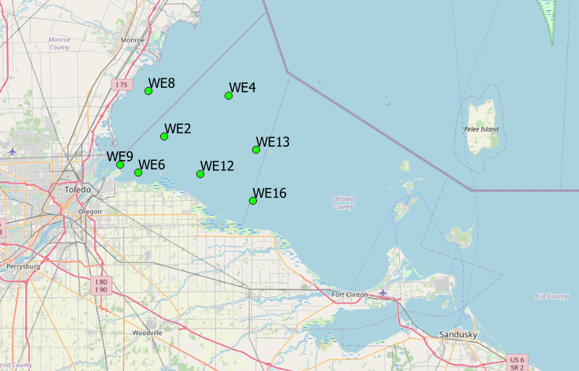
Background
HABs: Harmful Algal Blooms. Come from eutrophication.
Sentinel-2: 10m resolution monitoring satellite
Images every point on Earth every 15 days
Study Area: SW Lake Erie, Maumee river
Set of 8 HAB monitoring stations run by NOAA
Some with continuous monitoring, some with field sampling only

Slide 3
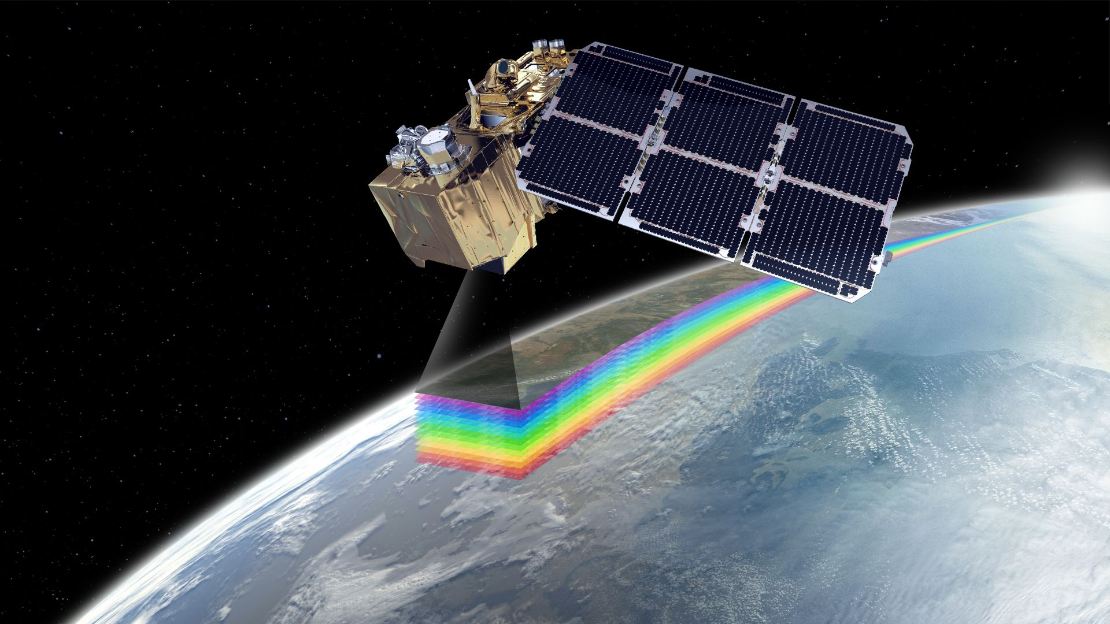
Data Source
HAB stations publically available from NOAA (2014-present)
632 Sentinel-2 images in area
Masked clouds
Sampled mean pixel intensity within 50m of stations
Downloaded as CSV – joined together
649 observations over 120 distinct dates
Issues faced
No direct measurement of cyanobacteria cell counts
Instrument package changed year to year

Slide 4
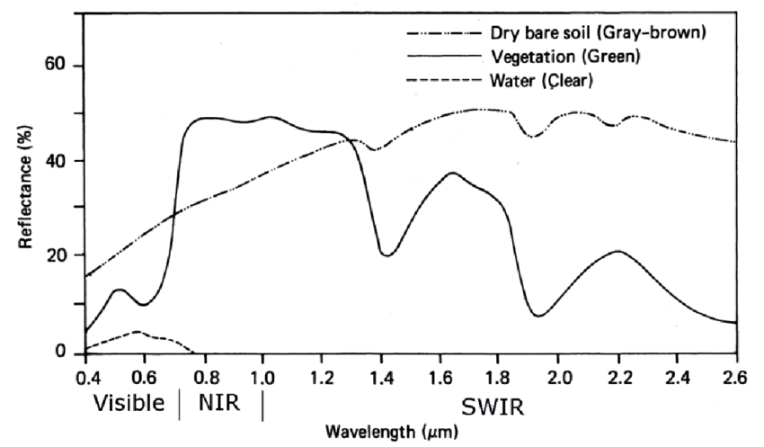
B10
B11
B12
Bands 1-9

Slide 5
Questions to answer
Can satellite data be used in place of buoy data to model algae occurrence?
What combination of satellite bands is most effective for modeling algae?

Slide 6
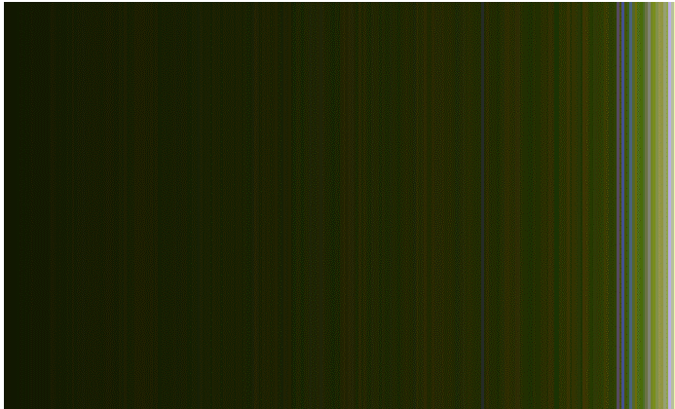
Observations include some green, are these HABs?

Slide 7
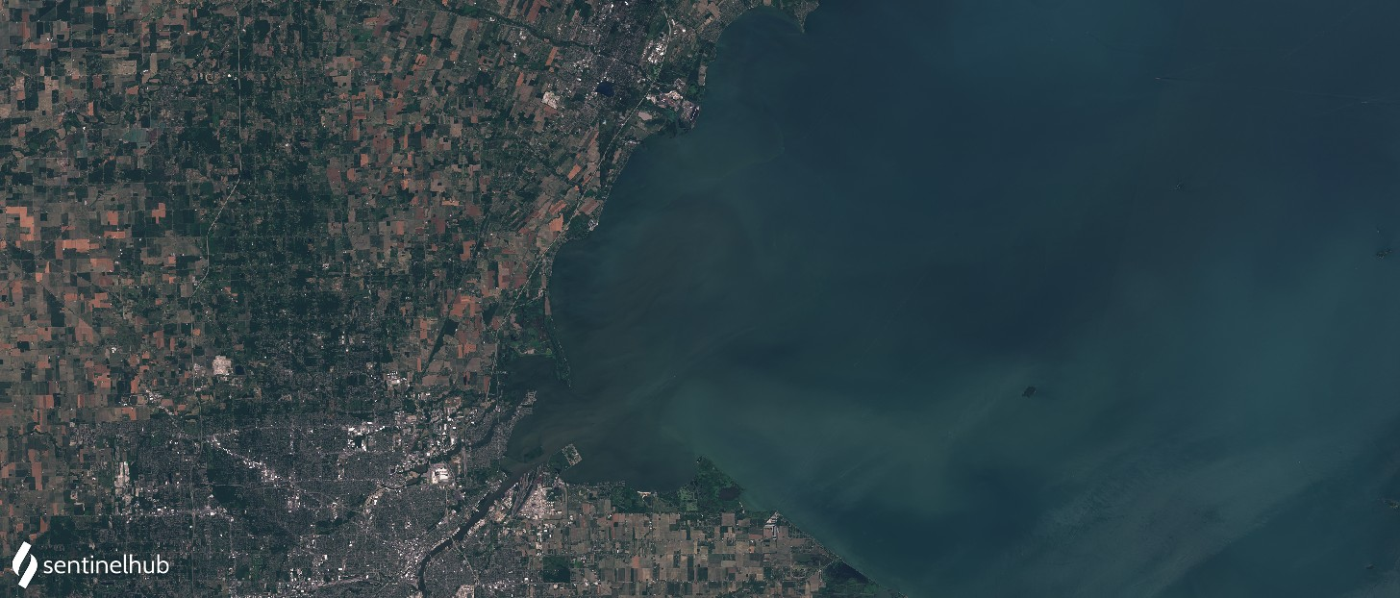
2018-11-26
Is this a HAB?

Slide 8
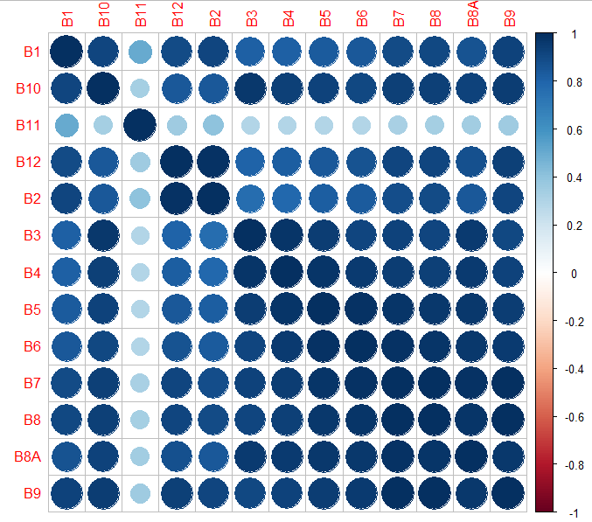
Dimensionality reduction isn’t applicable due to almost perfect multicollinearity

Slide 9
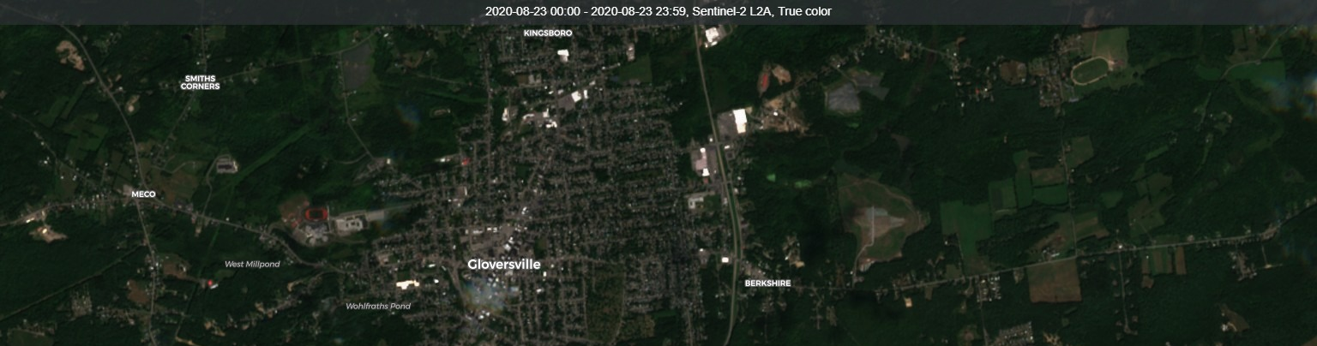
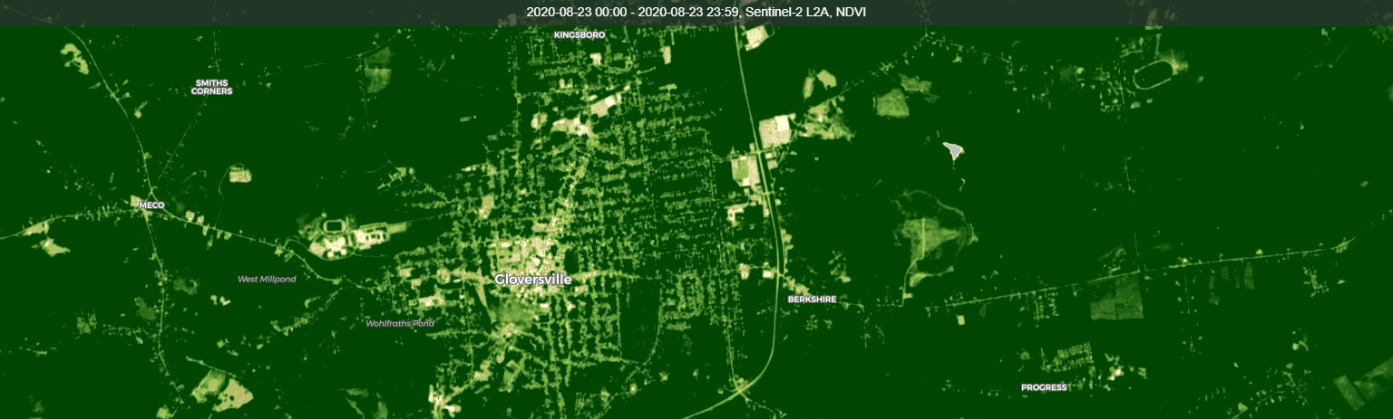
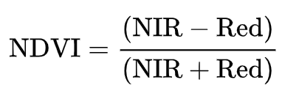
Building indexes from band intensity is another way to reduce dimensionality

Slide 10
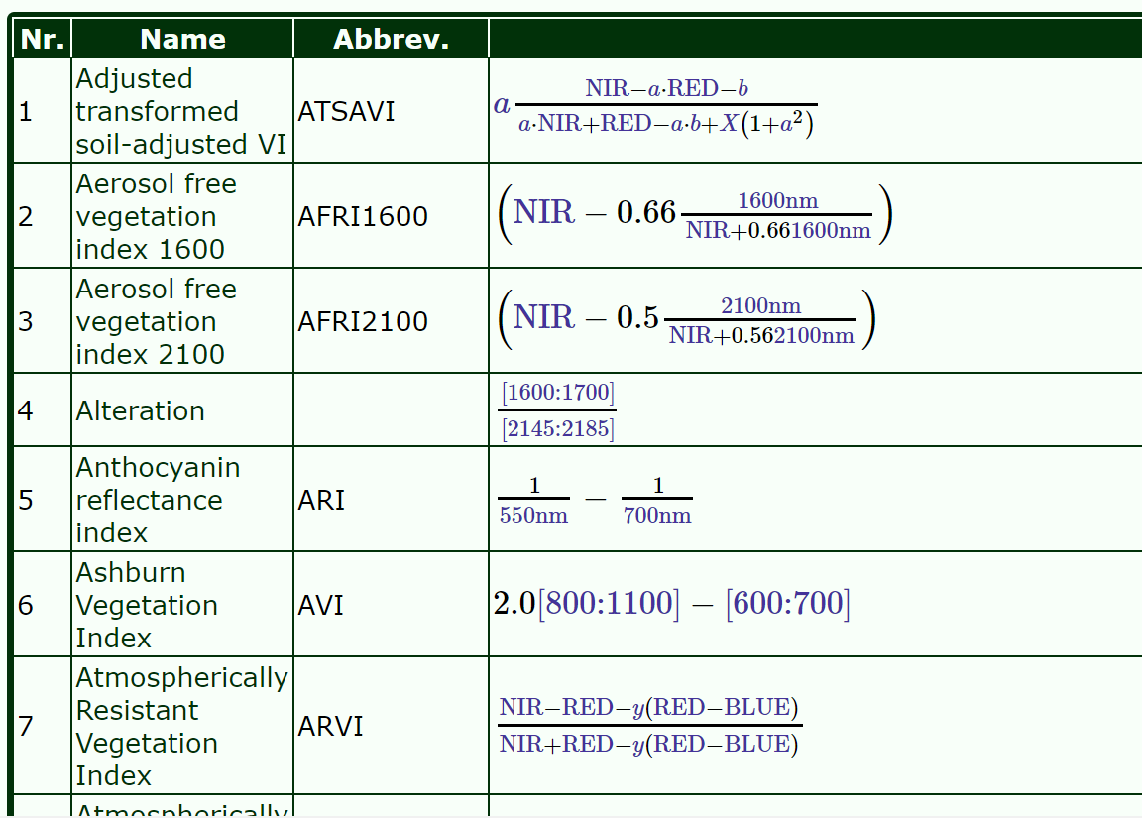
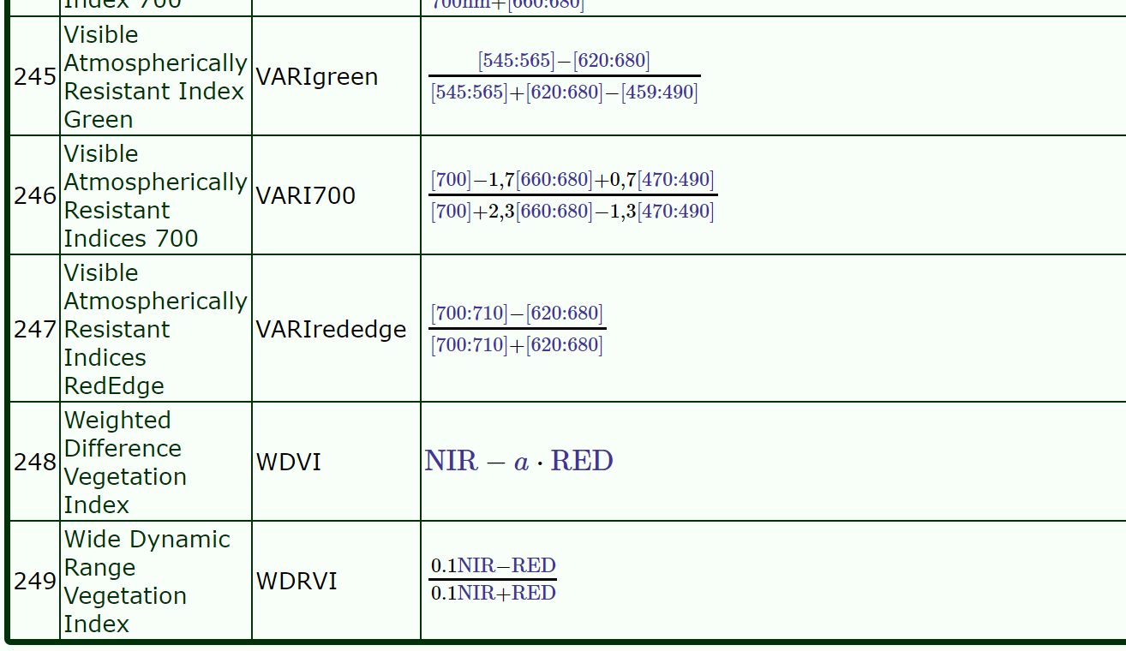
...

Slide 11
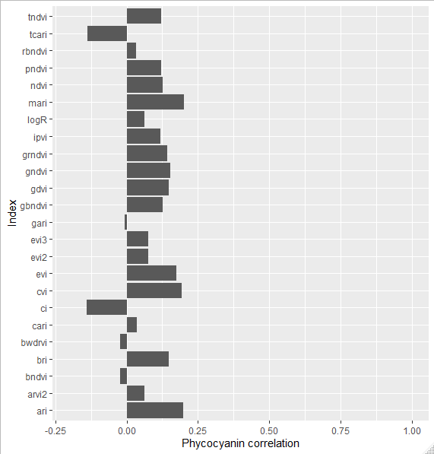
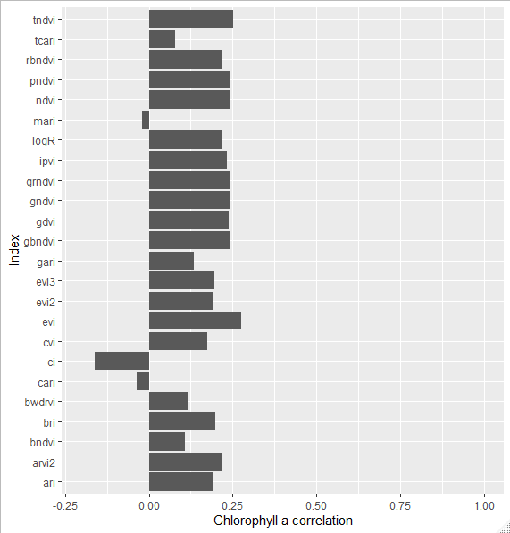
NDVI + 22 other indices, do any of them correlate well with chlorophyll or phycocyanin RFU?

Slide 12
Highly correlated data calls for neural network or random forest, do they work?

Slide 13
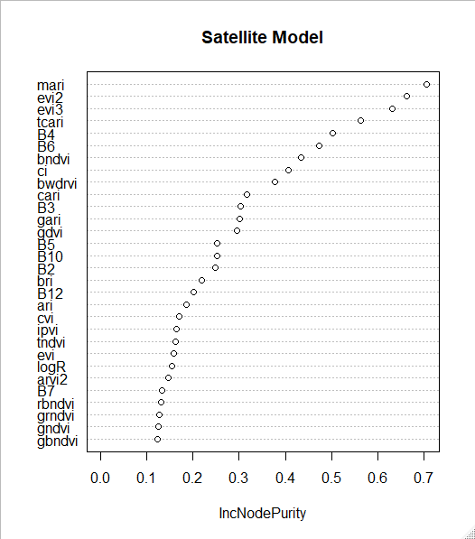
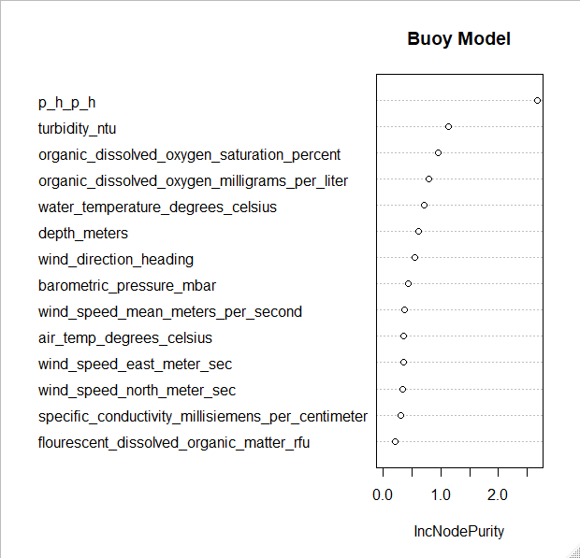
MSE 0.138 RFU
MSE 0.0978 RFU

Slide 14
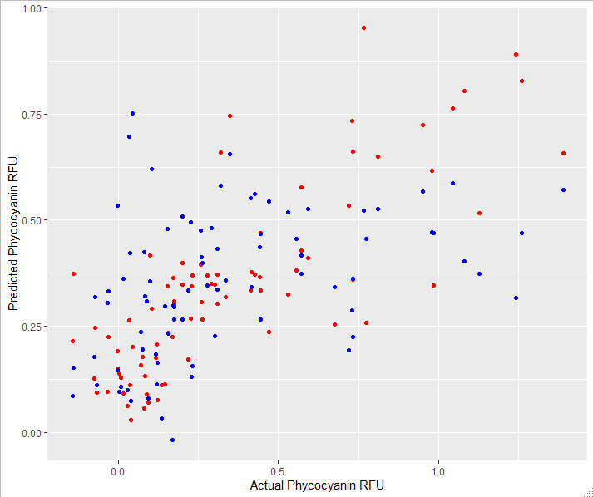
Buoy
Satellite

Slide 15
Conclusions
A random forest model of satellite indices performed only slightly worse than a model trained on buoy data.
The best satellite index to use is the modified anthocyanin reflectance index.
The strongest instantaneous predictor of phycocyanin was pH
Neural networks did not accurately predict phycocyanin or chlorophyll a reflectance.

Slide 16
Future Questions
Does lagging the data by a few days improve predictions?
Are other satellite sensors more effective?
S3 OLCI

